Slide 1
Let’s Talk About Dates…
#1
#2
#4
#3
#5
#6
#7
Notes:
Explain each of the date fields one by one. Make sure to say that Last Eval is NOT the date the eval was written.
Also, go over the IEP life cycle. Begin with an initial, go to the annual, the next annual, then the triennial. This repeats until the student exits Special Education via one of the exit field codes. (Moves, is no longer eligible, dies, ages out, graduates with a diploma or a certificate of completion, parent revokes special education, etc.)
If the student exits Special Education (Let’s say as a preschooler, receiving Speech services), then is re-evaluated for Special Education (Let’s say as a 4th grader) and qualifies, that would start a whole new IEP lifecycle over again, beginning with an initial IEP, and progressing through. In this case, the Original Entry date DOES NOT change from the first (preschool) Special Ed Entry Date.

Slide 2
What About Amendments?
The amendment form should NOT be used –
When the purpose of meeting is an initial, annual, triennial or 30-day interim placement
An amendment form should be used for any other type of IEP meeting!!!!!!!!!!
The amendment form is found only in the Current IEP in SEIS
Additional IEP pages may be added to the amendment as appropriate

Slide 3
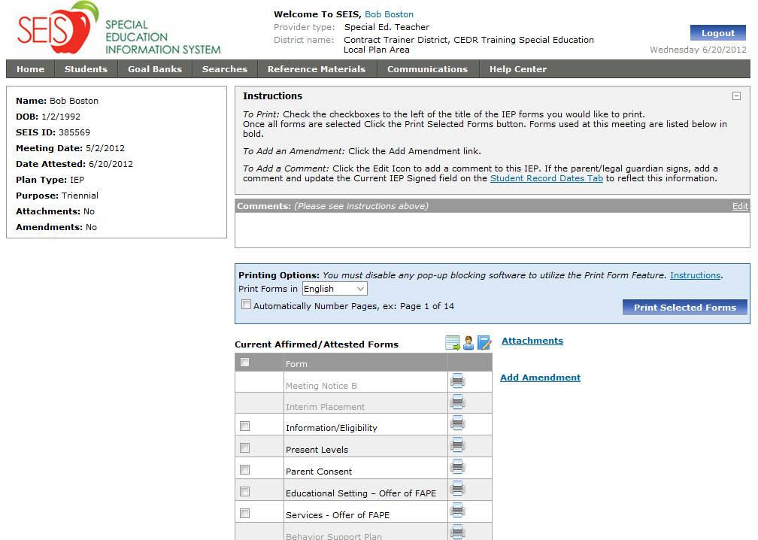
How to create an Amendment
To start an amendment you still click on the Add Amendment link found ONLY on the Current IEP

Slide 4
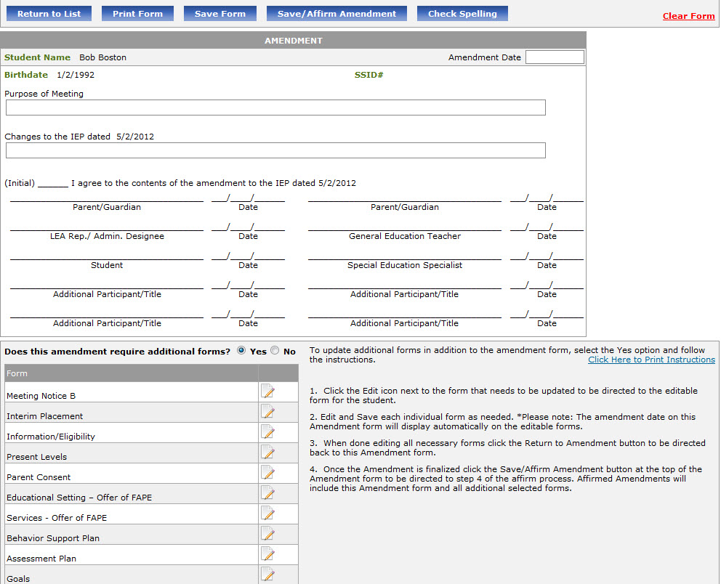
The Amendment Page
Save/Affirm Amendment to Affirm the amendment and close it out.
Date is Very Important!
Complete the form using the text boxes provided.
Instructions
If you are making changes to pages of the IEP, click yes, then click the edit link for the appropriate form and make the changes on the form. These automatically attach to the amendment now.

Slide 5
Accessing Additional Forms

Slide 6
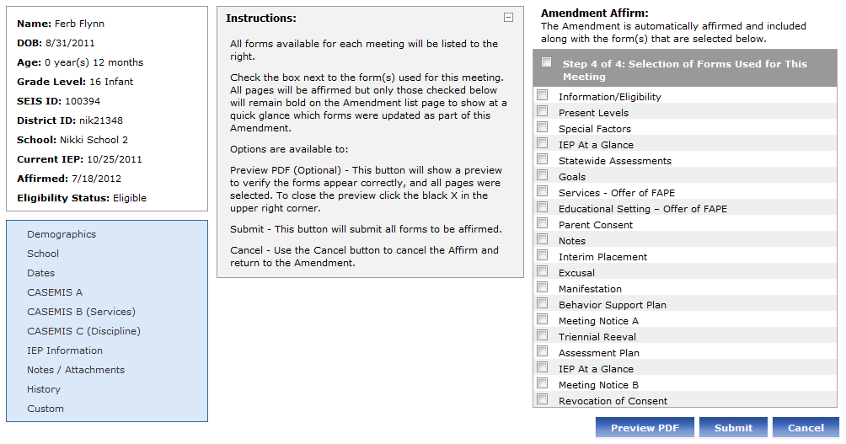
Affirming Amendments
Check all forms that have had changes made to them. Do not check them if they haven’t been changed.

Slide 7
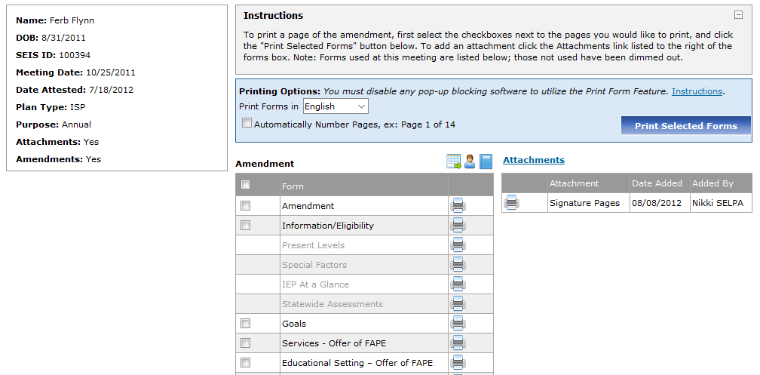
Printing the Complete Amendment
The forms you checked on Affirm and Attest will show up here to select from when printing.

